Slide 1
Traffic Capstone
Data Science Career Track
Harsha Teja Gorijavolu

Slide 2
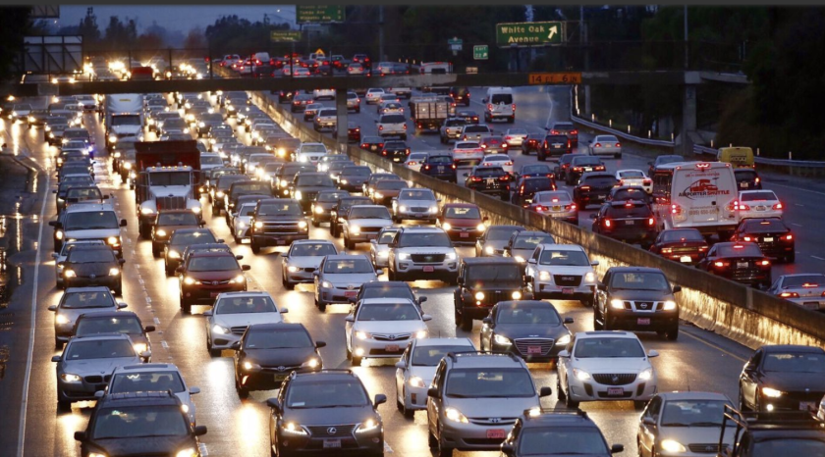
Proposal
Traffic can lead to a variety of hazards for our society by:
Significantly affecting people’s everyday lives by being annoyed
Having financial impacts for the entire society, but mostly for the trucking industry
Leading to a more dangerous life on and off the road
In order to combat this, I would like to research different attributes such as rain, temperature, holidays, etc.

Slide 3





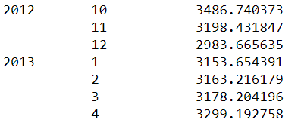
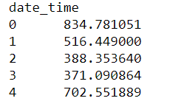

Data Wrangling
Data was taken from a machine learning repository in csv format and converted into a series of tables that list one attribute and traffic volume.

Slide 4
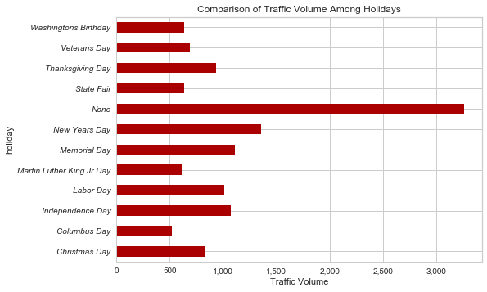
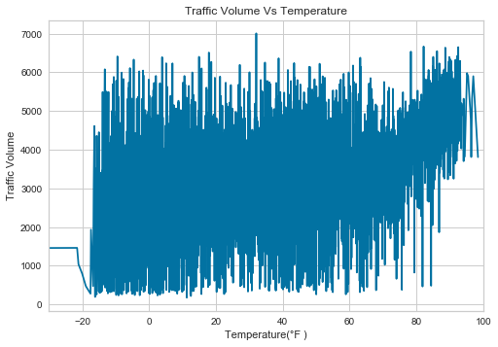
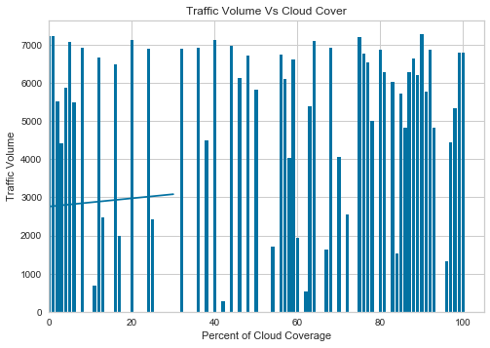
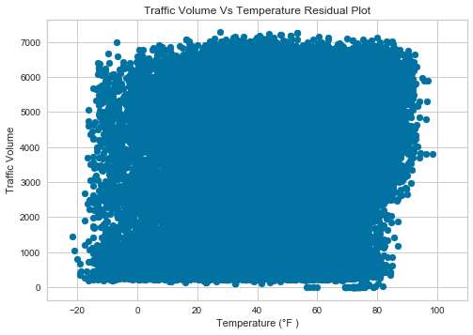
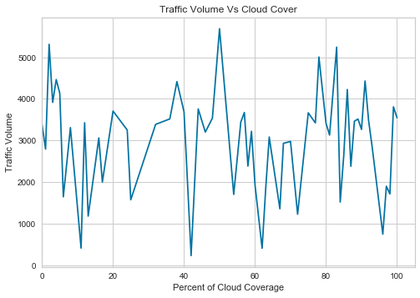
Data Storytelling/Visualizations

Slide 5
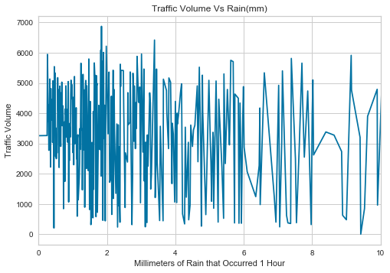
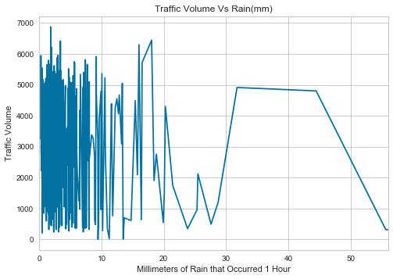
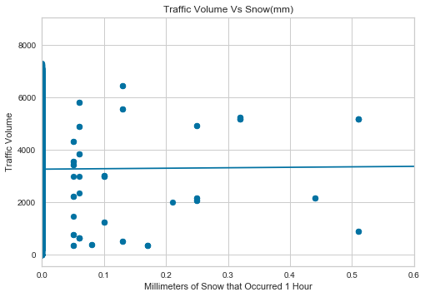
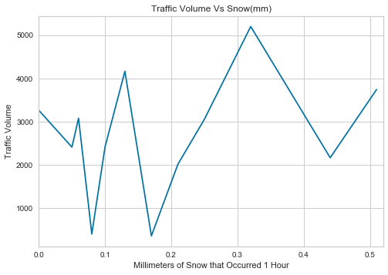
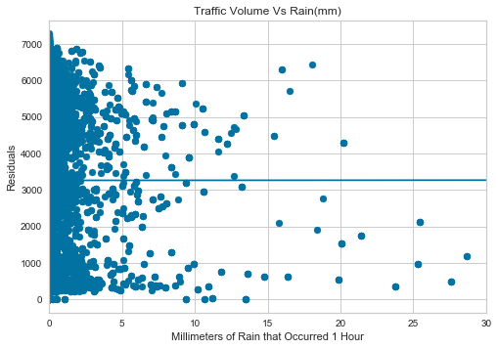
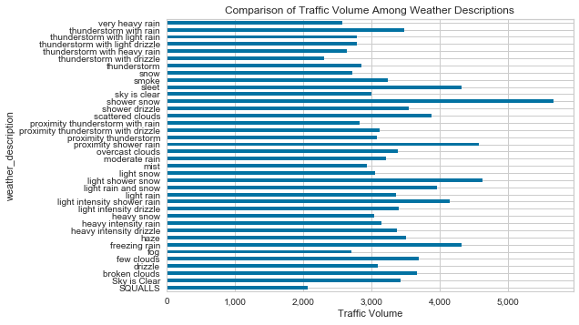
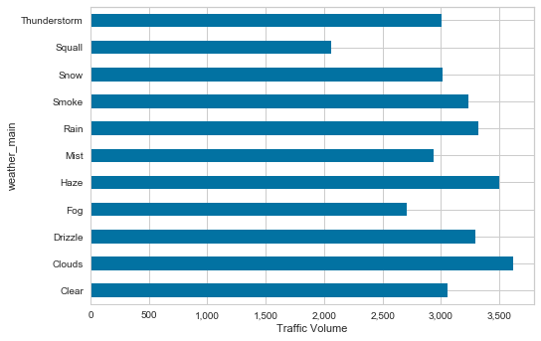

Slide 6
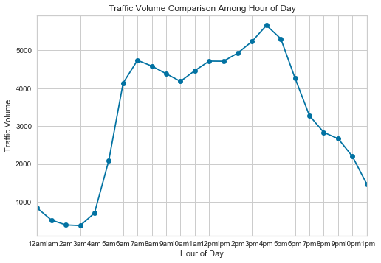
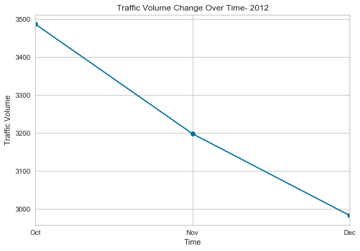
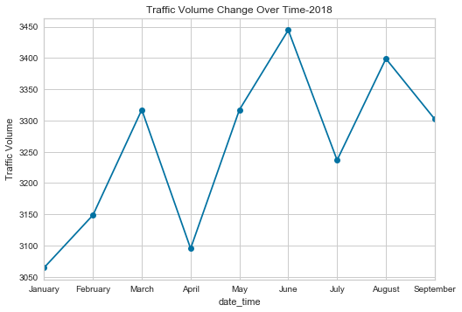
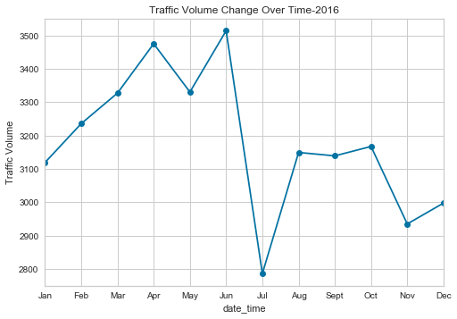
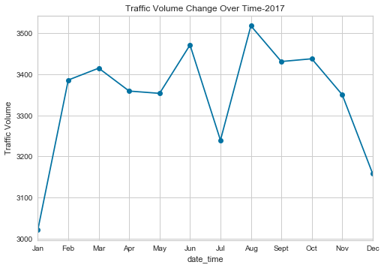
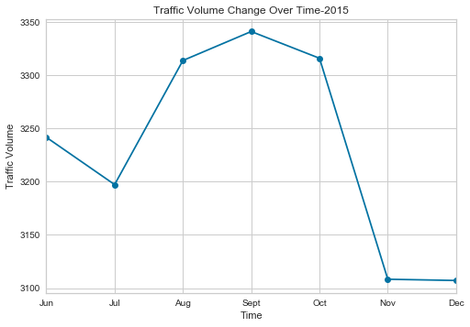
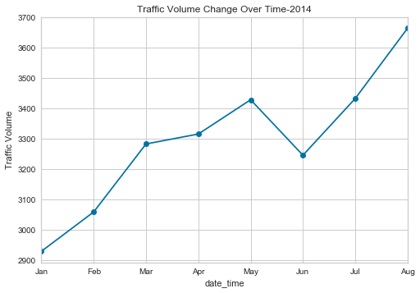
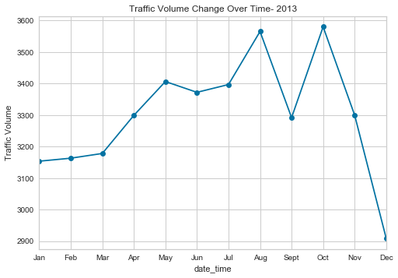

Slide 7
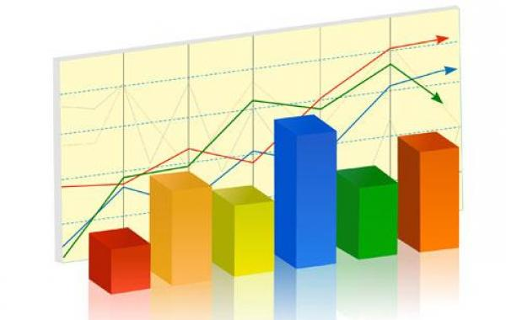
Statistical Analysis
Chi Square analysis and Pearson correlation was done to determine statistical significance of differences between attributes

Slide 8
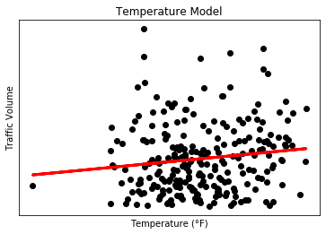
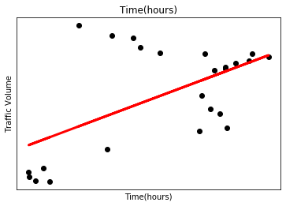
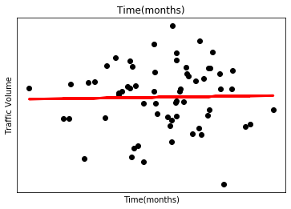
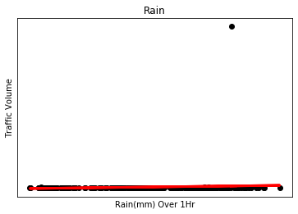
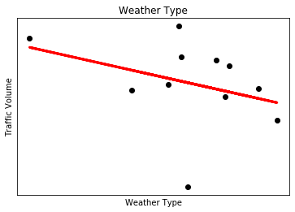
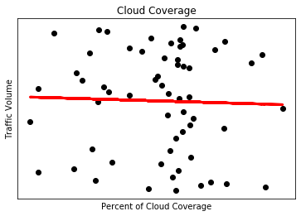
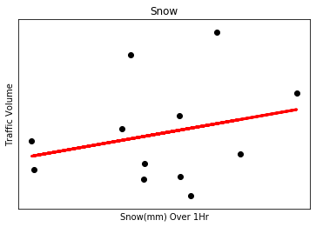
Machine Learning Analysis
Regression analysis was performed on the data

Slide 9
Works Cited
https://www.google.com/search?q=traffic&safe=off&rlz=1C1GGRV_enUS756US756&tbm=isch&sxsrf=ACYBGNRCDQ2PI_E3yJdoZDplXV6Pr8WItg:1577930598082&source=lnms&sa=X&ved=0ahUKEwiEpp3G6ePmAhUGnFkKHYeJAO0Q_AUIDCgD&biw=1396&bih=612&dpr=1.38#imgrc=kOHn7EOr_TTIkM:
https://www.google.com/search?q=statistics&safe=off&rlz=1C1GGRV_enUS756US756&sxsrf=ACYBGNQO44_bmbzbjgWItuY9Aeg-Ew4uPQ:1577931433974&source=lnms&tbm=isch&sa=X&ved=2ahUKEwji_ufU7OPmAhVOm-AKHSfIBwcQ_AUoAXoECBQQAw&biw=1396&bih=612#imgrc=3j8h8B3urpJNsM:

